Slide 1

REPORT
Michael Lee
October 6th, 2022

Slide 2
What was accomplished

Slide 3
WISHED/Phase Recovery
Code for generating synthetic WISHED data
Has a model-based and some non-model-based modes
WISHED processing code
Phase recovery code
Model-based, uses SLM patterns and image sensor data
NOTE: I did not get around to implementing a PyTorch Lightning module for the optimization.
Synthetic wavelength code
I.e. pointwise-multiplying fields together (with one being complex-conjugated)
Depth recovery code
NOTE: My depth recovery code has/might have some flaws, as explained later. At the very least, I forgot to do phase unwrapping.
NOTE: All code was written using PyTorch and Holotorch.

Slide 4
Holotorch Stuff
Documented bugs in Holotorch that I encountered
Wrote code to fix/work around bugs when needed
Did so without modifying Holotorch source code itself
(Good thing Python supports inheritance)
Implemented new classes in Holotorch
Thin lens component
Field padder/unpadder
Field resampler
Et cetera

Slide 5
DETAILS

Slide 6
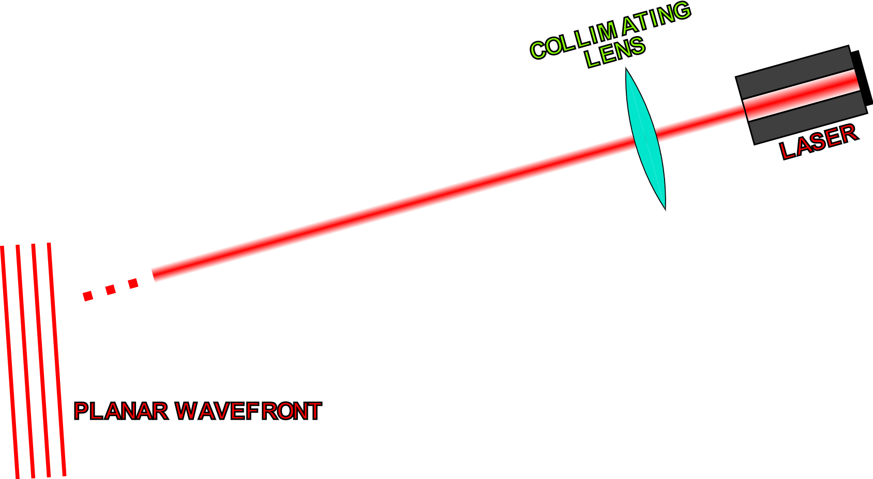
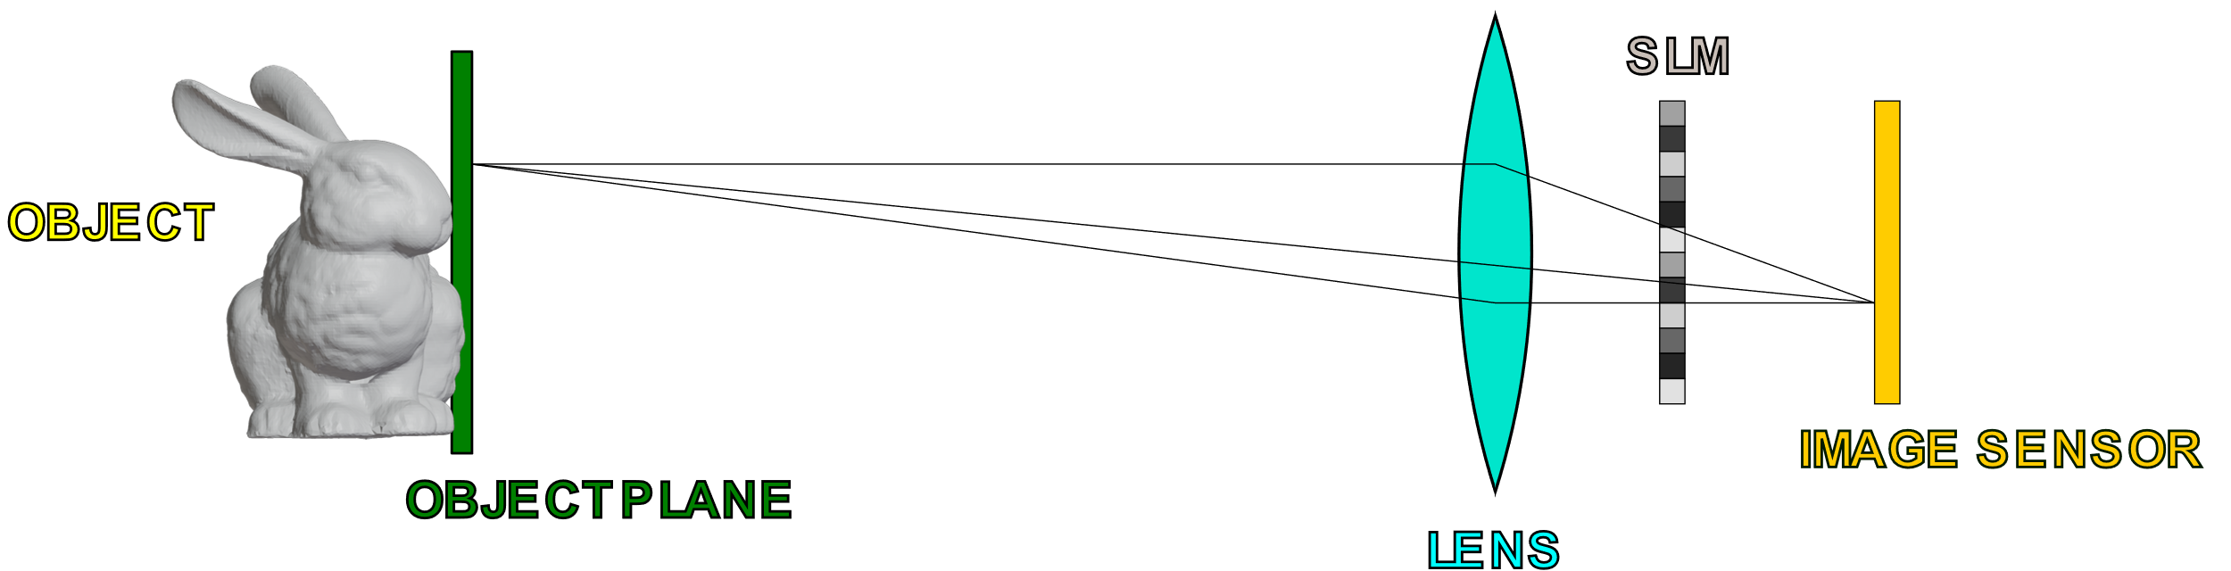
Real Life Setup and General Objective
OBJECTIVE
Recover the complex field (amplitude and phase) on the image sensor plane (without the SLM)
Use the recovered phase to obtain the depthmap of the object.
NOTE: Phase-only SLM

Slide 7
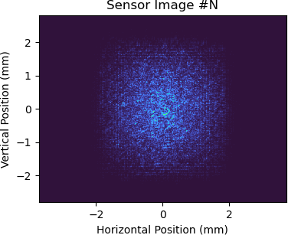
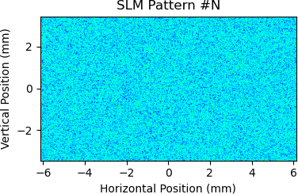
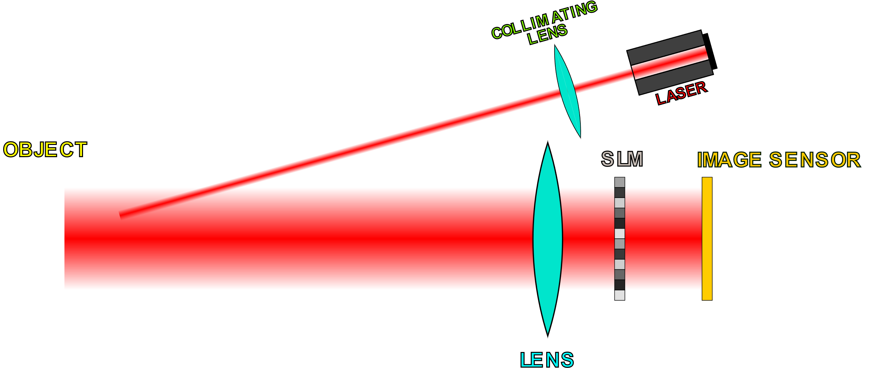
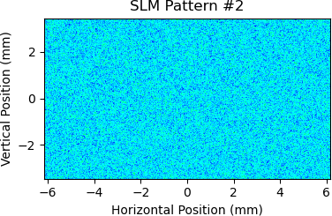
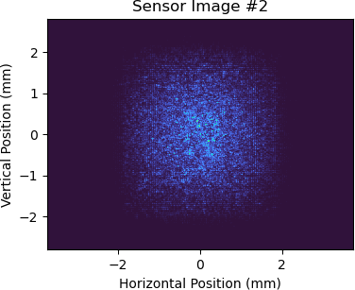
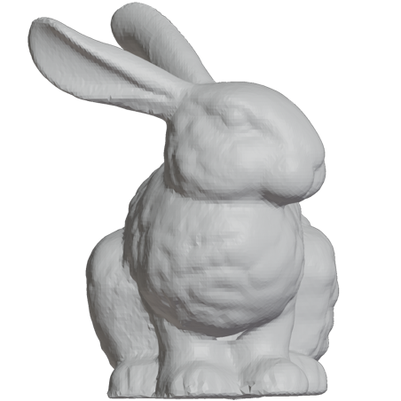
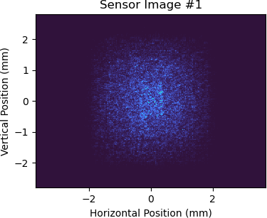
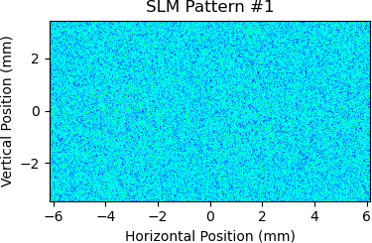
Obtaining Real (Non-Synthetic) Data
Save SLM and sensor data
Recorded Data
Acquire image from sensor
…
Display random phase pattern on SLM
Can use this data in conjunction with a model for SLM-to-sensor propagation to recover the complex field at the image sensor

Slide 8
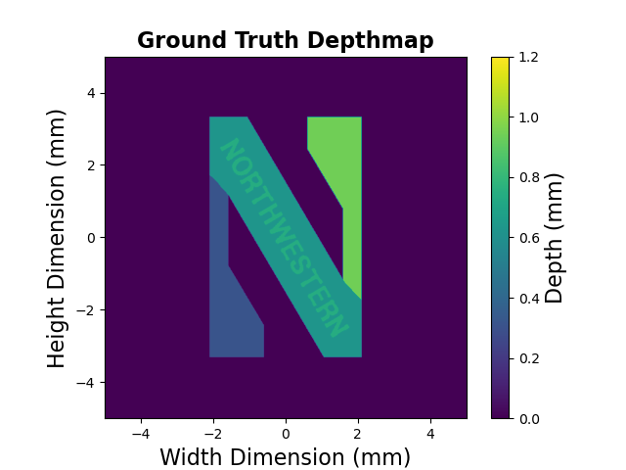
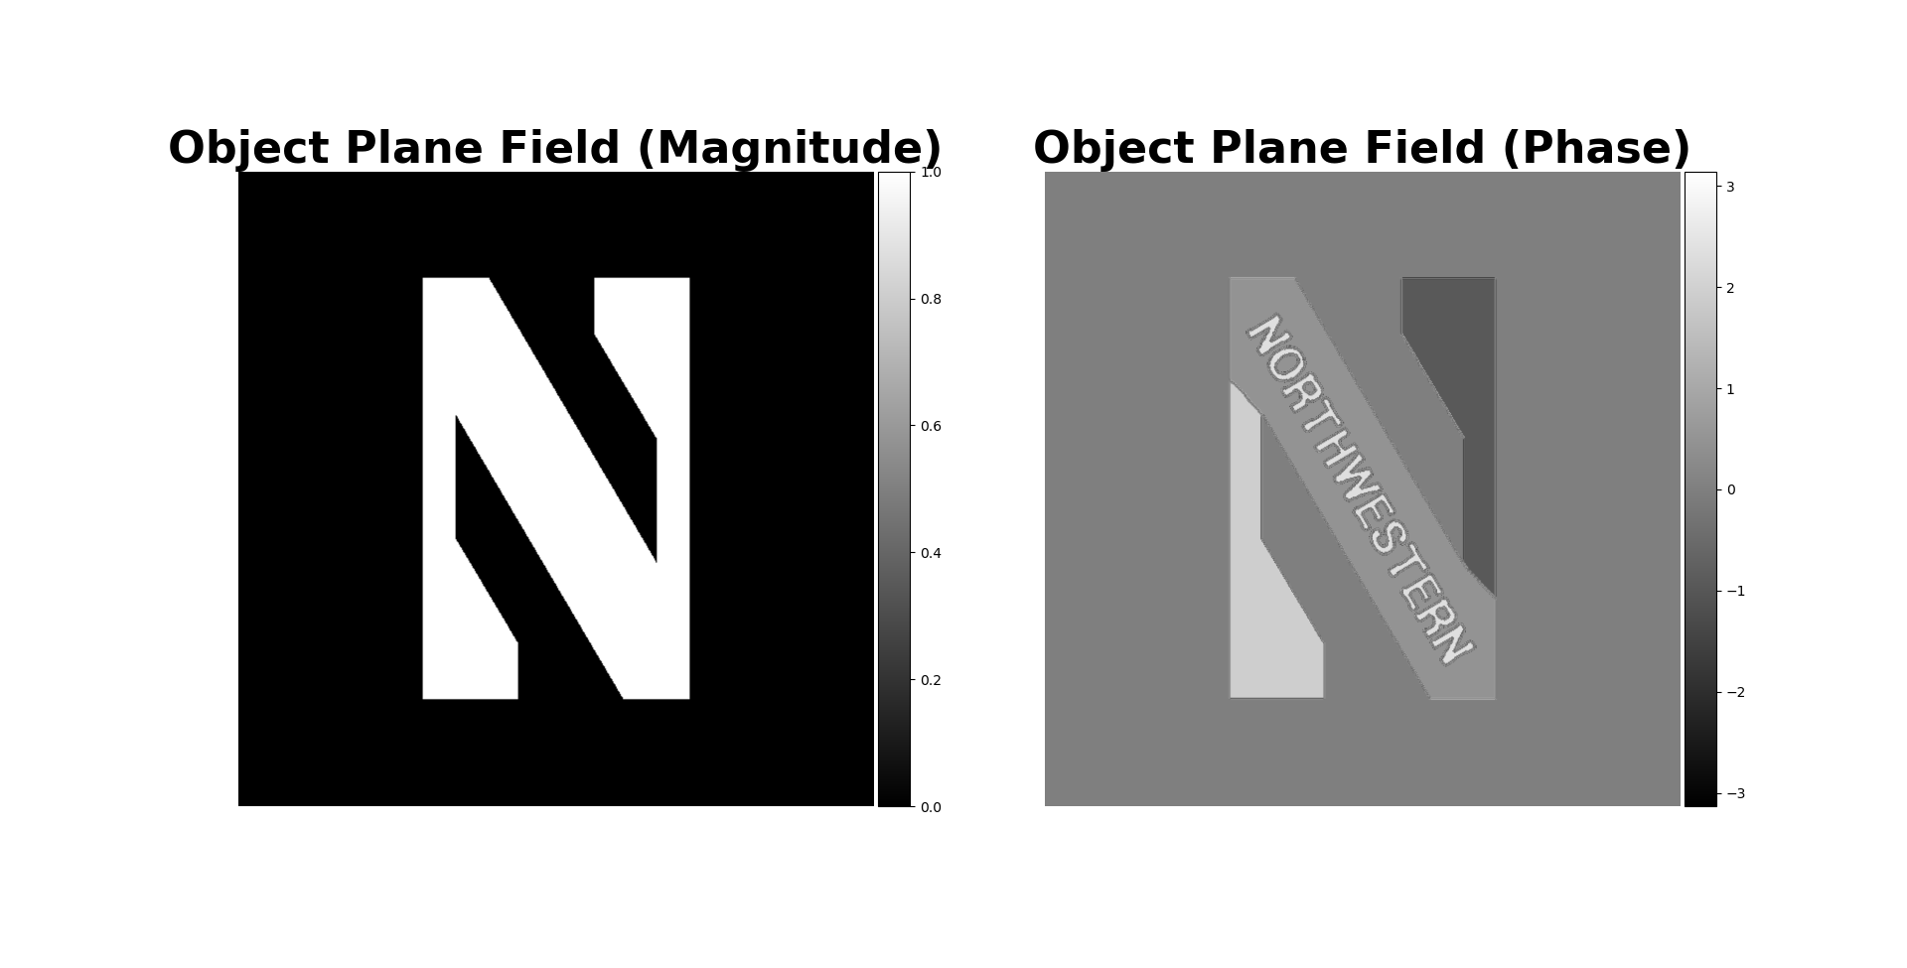
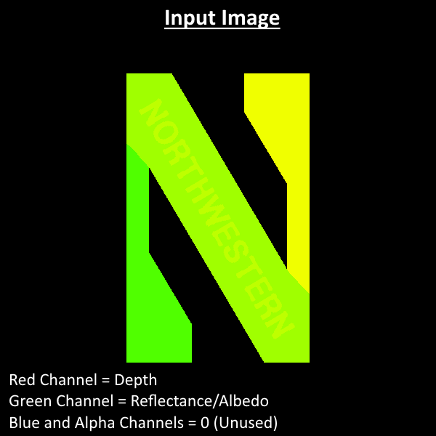
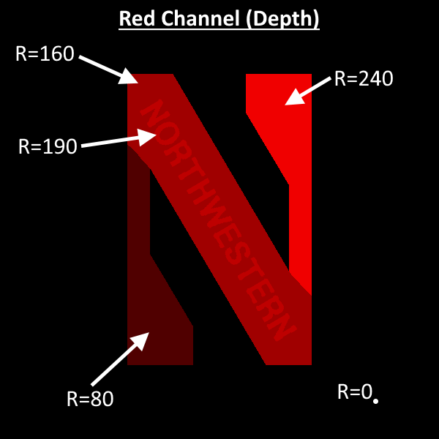
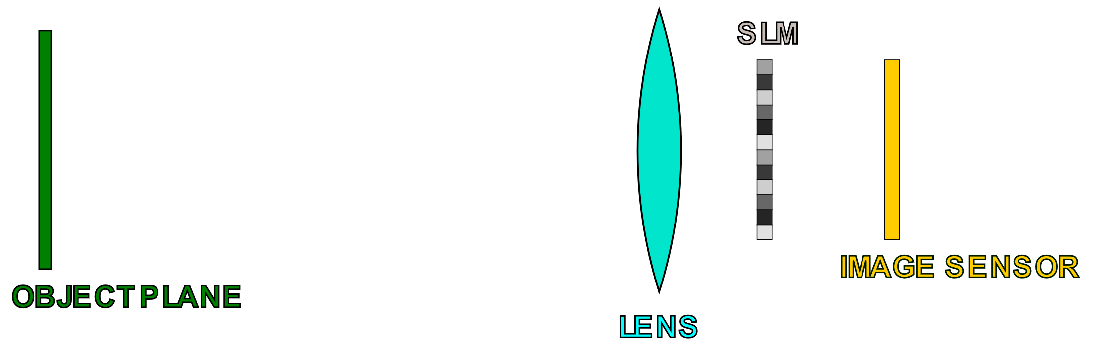
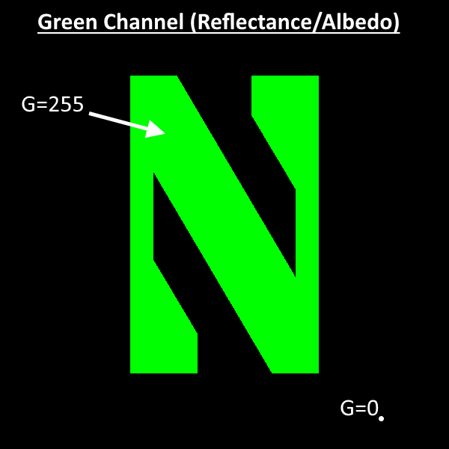
Generating Synthetic Data
NOTE
Synthetic data code has some modes/options (e.g. ray optics) that do not utilize a model like this.
Specify a ground truth depthmap
via an image
Use depth map to
generate object plane
fields
SYSTEM MODEL
. . .
Specify a model for the system
Feed the calculated object plane fields into the system
Can simulate the real-life WISHED data collection process.
Sensor plane and SLM images are saved.

Slide 9
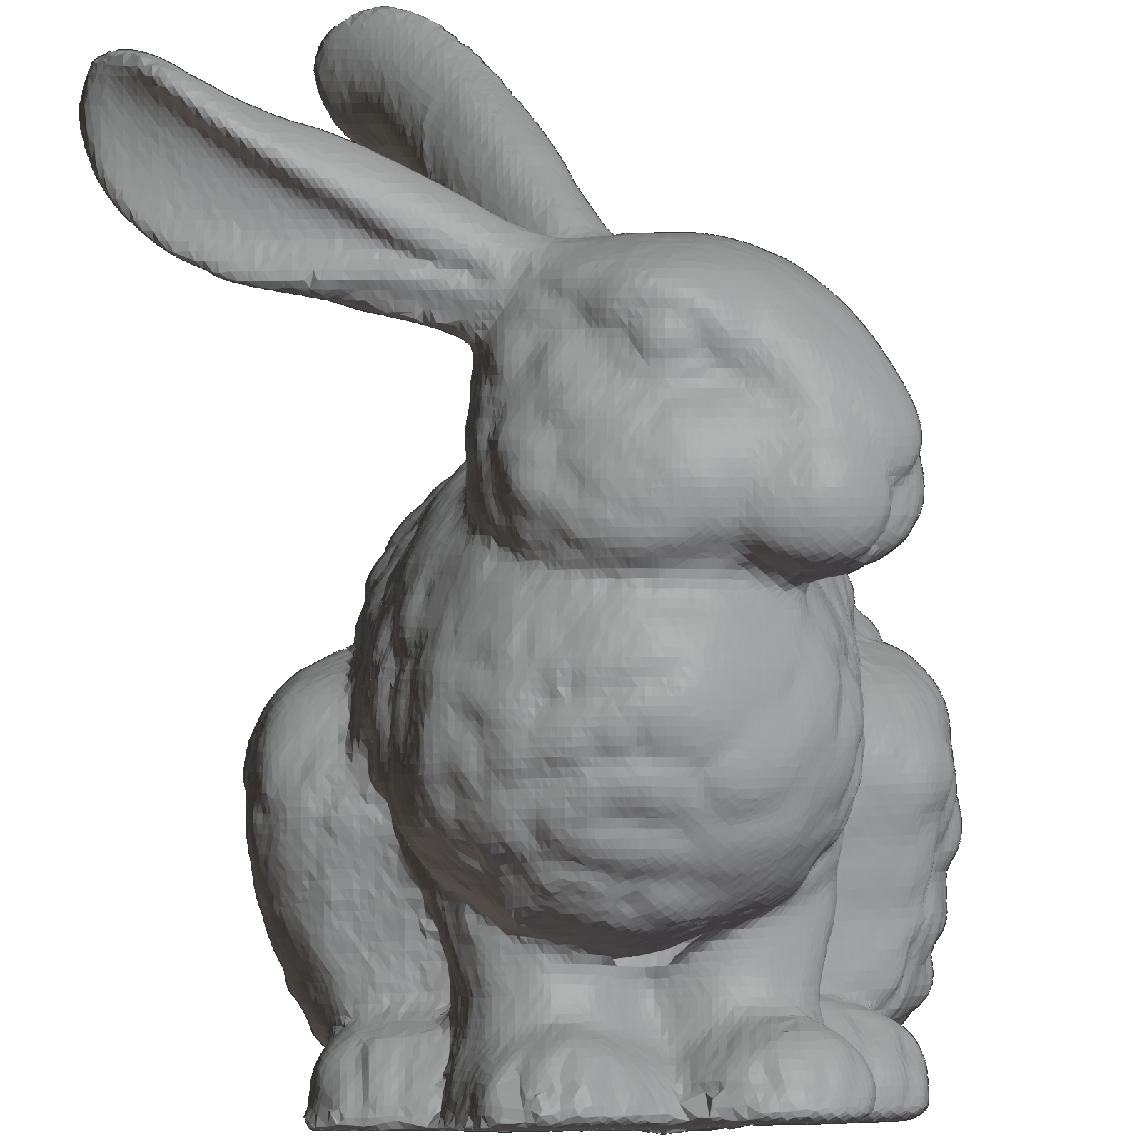
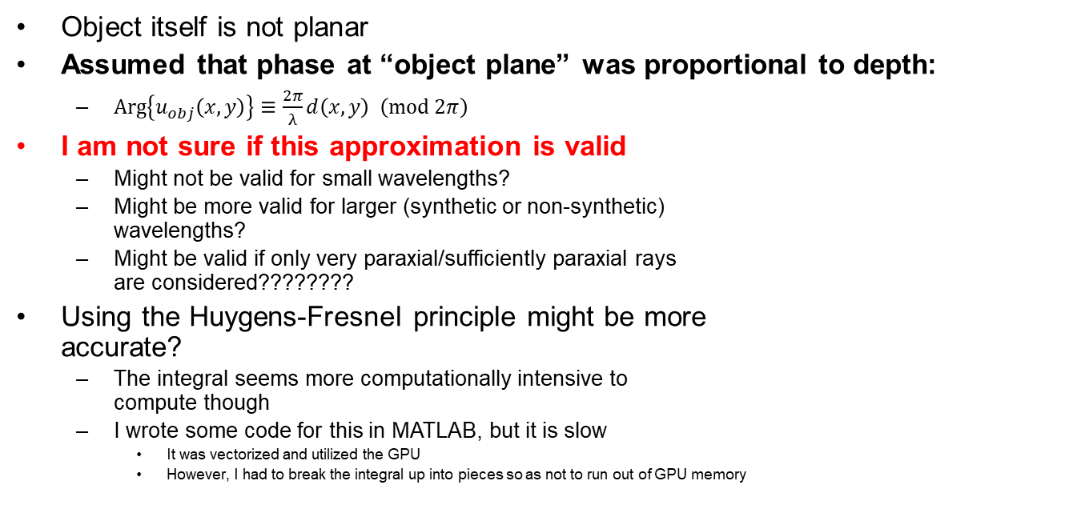
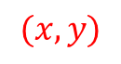
Computing Object Plane Field from Depthmap
Object itself is not planar
Assumed that phase at “object plane” was proportional to depth:
$\operatorname{Arg}\left\{u_{obj}\left(x,y\right)\right\}≡\frac{2π}{λ}d\left(x,y\right) \left(\operatorname{mod}{2π}\right)$
I am not sure if this approximation is valid
Might not be valid for small wavelengths?
Might be more valid for larger (synthetic or non-synthetic) wavelengths?
Might be valid if only very paraxial/sufficiently paraxial rays are considered????????
Using the Huygens-Fresnel principle might be more accurate?
The integral seems more computationally intensive to compute though
I wrote some code for this in MATLAB, but it is slow
It was vectorized and utilized the GPU
However, I had to break the integral up into pieces so as not to run out of GPU memory
$$d(x,y)$$
$$(x,y)$$
Object plane

Slide 10
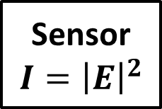
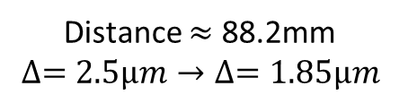
Synthetic Data System Model
Focal Length = 75mm
Diameter = 50.8mm
ASM
Propagation
Thin Lens
Follows setup from 2020 WISHED paper
Distance = 50cm
Object Plane
Field
Sensor is placed at the image plane.
Fresnel
Two-Step
Propagator
Sensor
$$I={\left|E\right|}^{2}$$
The Fresnel two-step propagator was used to propagate between planes of different resolutions. It was used because the image on the image plane is comparatively small relative to the object plane fields.
Sensor Plane
Field
Distance $≈$ 88.2mm
$$∆=2.5μm→∆=1.85μm$$
Fresnel Two-Step Propagator
"Computational Fourier Optics: A MATLAB Tutorial“
by David Voelz

Slide 11
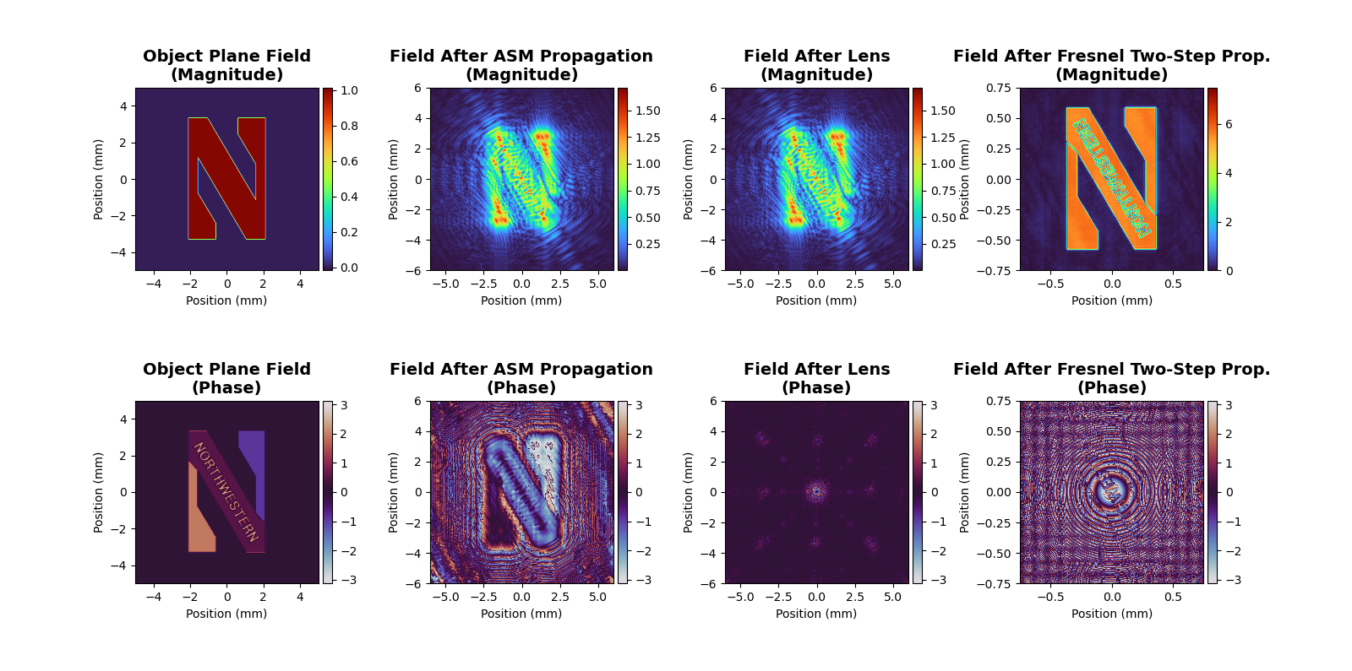
Synthetic Data System Model Fields
Field at sensor plane
Ran into some GPU memory and numerical/computational issues (the latter mainly arising from the Fresnel two-step propagator).
Thus, was unable to get the image on the sensor plane to be bigger.

Slide 12
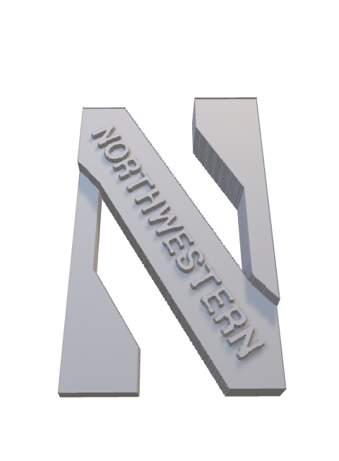
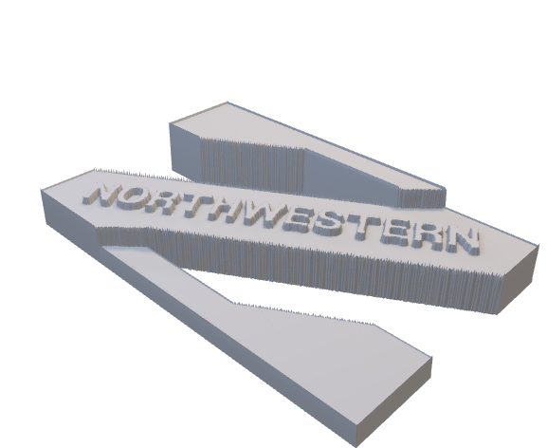
Visualizing the Test Object
NOTE: The 3D model was not used for computations.
It is a just a visualization of the depthmap.

Slide 13
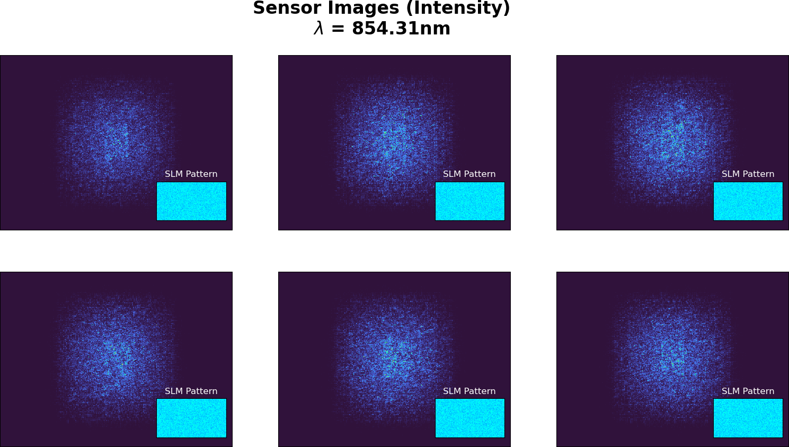
Synthetic Data Example

Slide 14
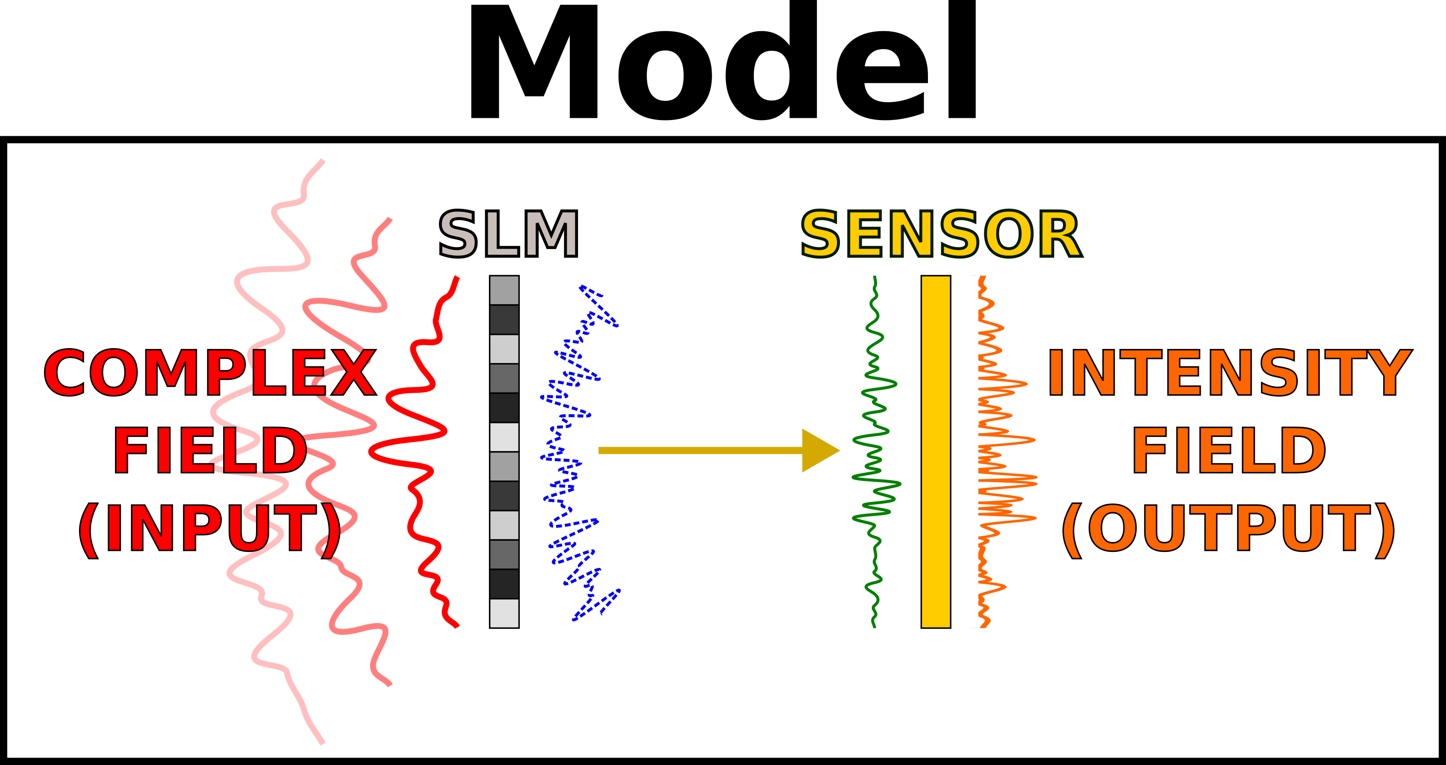
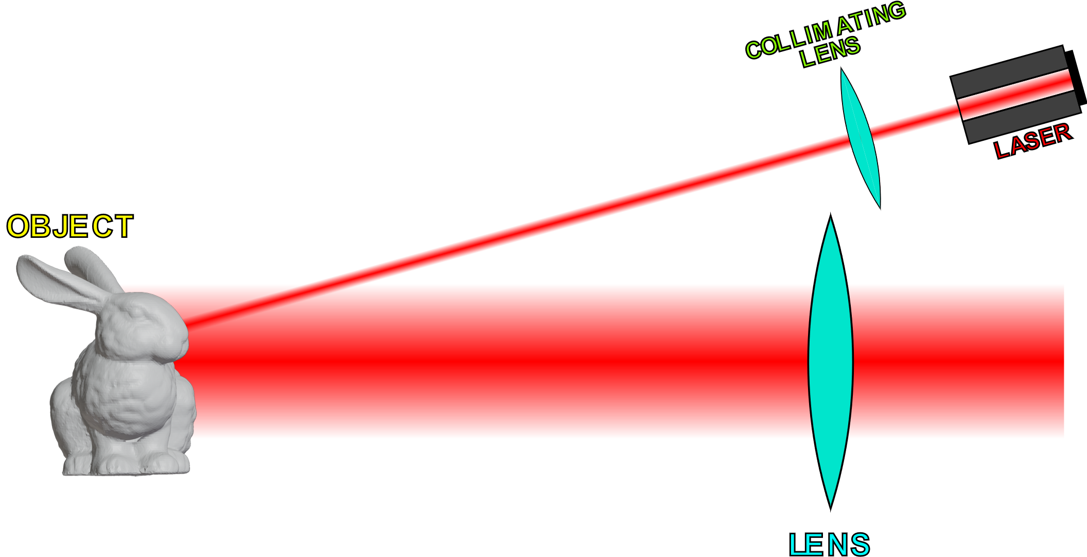
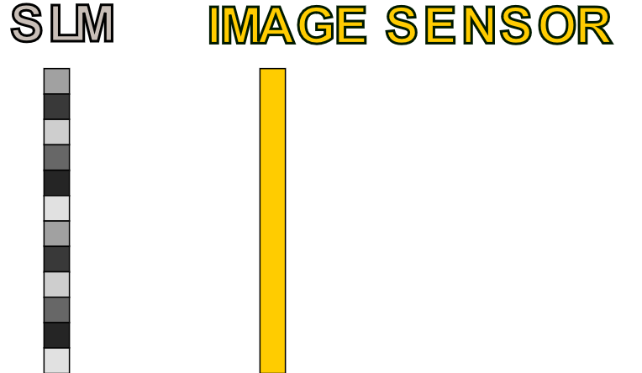
Recovering Complex Fields
Objective
Recover field (phase + amplitude) at
the image sensor
Phase Retrieval
Algorithm
Sensor Plane
Complex Fields
Can do phase retrieval
to accomplish this
]
…
SLM Patterns
and
Sensor Data
This data is measured
(or synthesized)
Can focus on SLM and sensor
while disregarding the rest

Slide 15
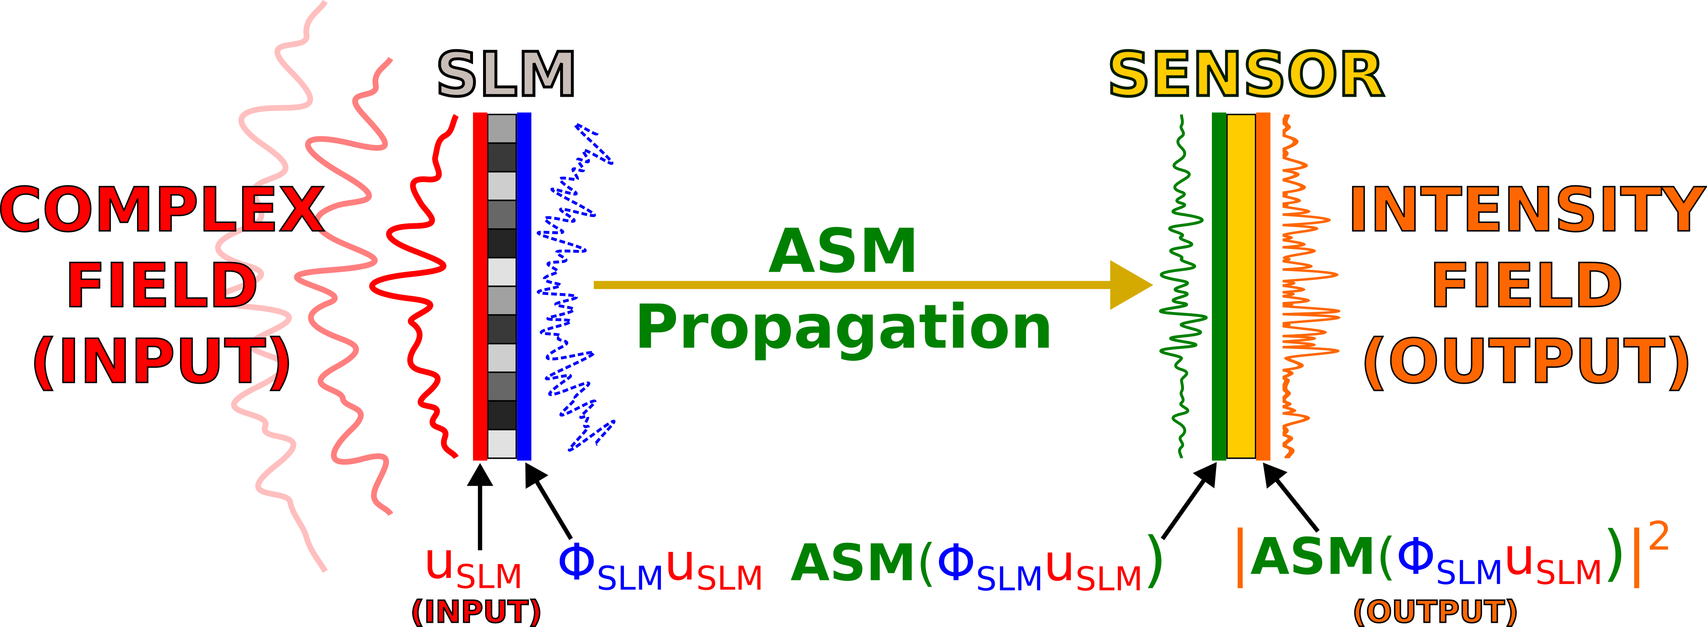
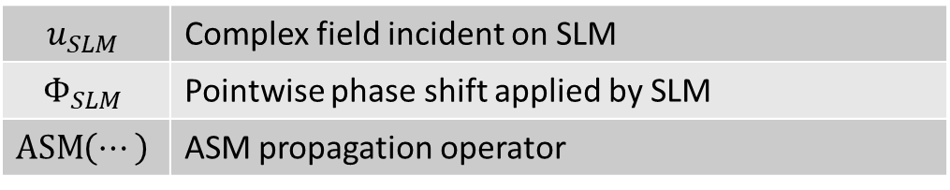
Forward Model
$$u_{SLM}$$ | Complex field incident on SLM
$$Φ_{SLM}$$ | Pointwise phase shift applied by SLM
$$\operatorname{ASM}\left(⋯\right)$$ | ASM propagation operator

Slide 16
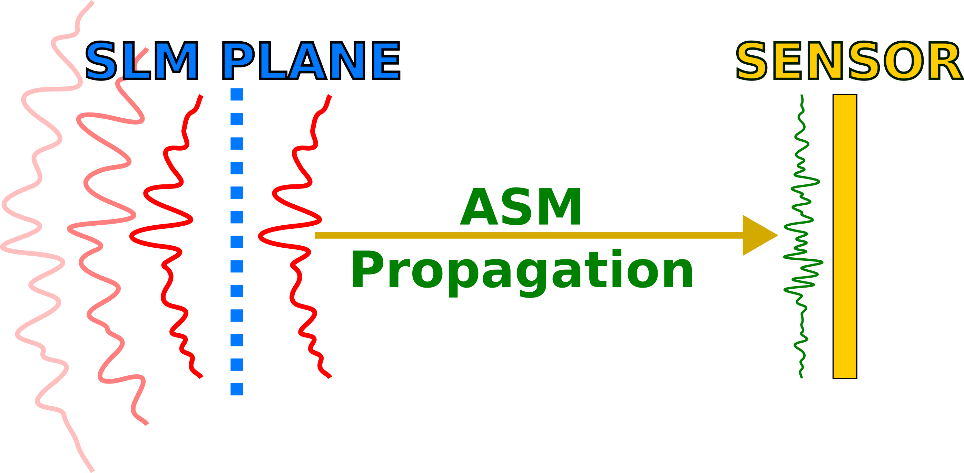
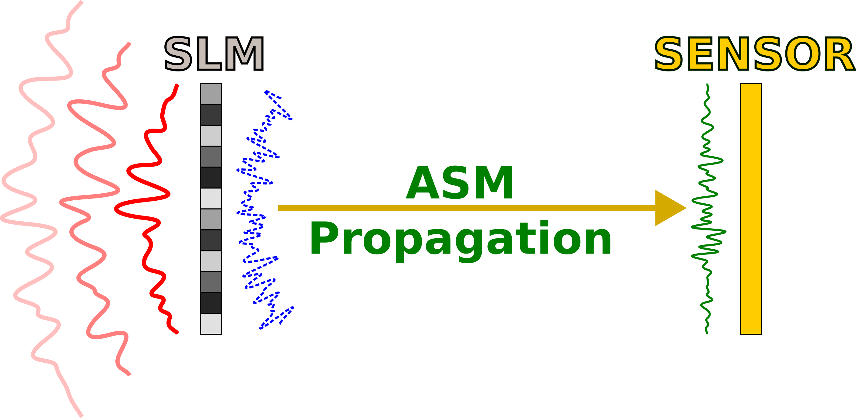
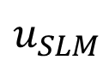
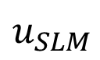

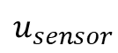
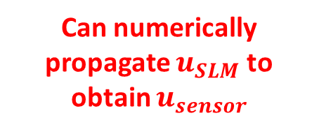
Recovering Sensor Plane Field
SUMMARY
To recover sensor fields:
1. Recover SLM input field
2. Numerically propagate the SLM input field to get the sensor field
Can assume $u_{SLM}$ is the input to the SLMs
Can numerically propagate $u_{SLM}$ to obtain $u_{sensor}$
$$u_{SLM}$$
$$u_{sensor}$$
$$u_{SLM}$$
Hypothetical field w/o SLM

Slide 17
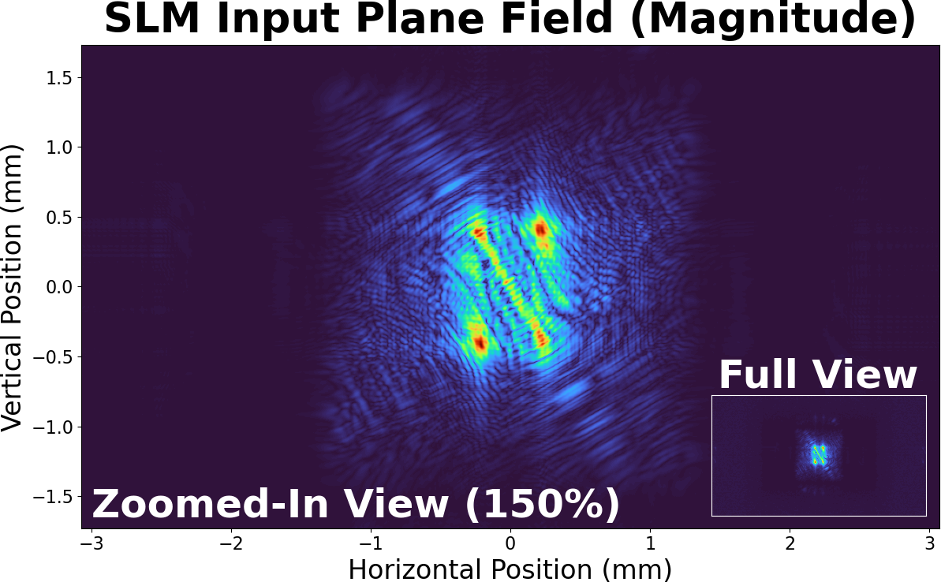
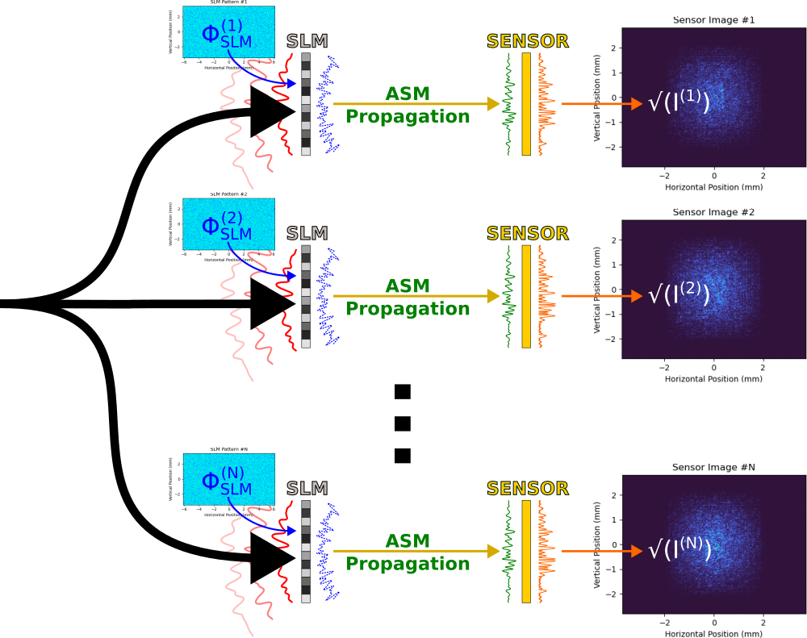
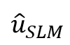
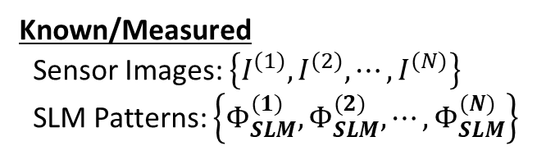

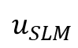
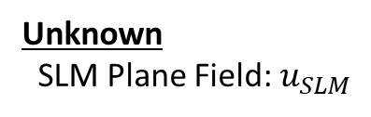
Estimating SLM Input with Optimization
?
Unknown
SLM Plane Field: $u_{SLM}$
$$u_{SLM}$$
Want to find a field ${\hat{u}}_{SLM}$ that gives approximately the same sensor images
$${\hat{u}}_{SLM}$$
Can use optimization accomplish this
Known/Measured
Sensor Images: $\left\{I^{(1)},I^{(2)},⋯,I^{(N)}\right\}$
SLM Patterns: $\left\{Φ_{SLM}^{(1)},Φ_{SLM}^{(2)},⋯,Φ_{SLM}^{(N)}\right\}$

Slide 18
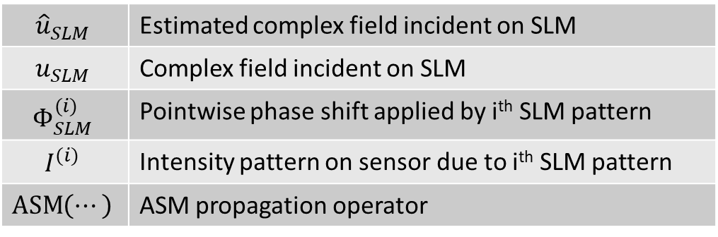
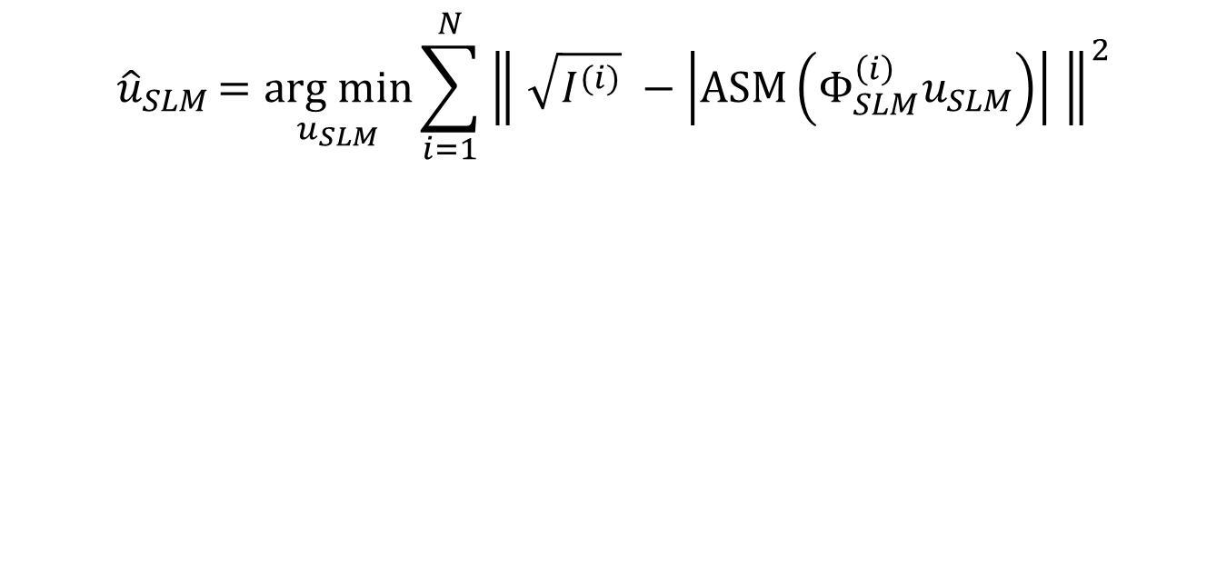
Optimization Objective Function
$${\hat{u}}_{SLM}=\underset{u_{SLM}}{arg min}{\sum_{i=1}^{N}{{\left\| \sqrt{I^{(i)}} −\left|\operatorname{ASM}\left(Φ_{SLM}^{\left(i\right)}u_{SLM}\right)\right| \right\|}^{2}}}$$
CORE IDEA |
Minimize error between measured intensity patterns and intensity patterns output by model
$${\hat{u}}_{SLM}$$ | Estimated complex field incident on SLM
$$u_{SLM}$$ | Complex field incident on SLM
$$Φ_{SLM}^{(i)}$$ | Pointwise phase shift applied by i^{th} SLM pattern
$$I^{(i)}$$ | Intensity pattern on sensor due to i^{th} SLM pattern
$$\operatorname{ASM}\left(⋯\right)$$ | ASM propagation operator
NOTE:
My actual implementation does something similar to batch gradient descent (batch ADAM???). Not all samples are evaluated at once like the equation above implies.

Slide 19
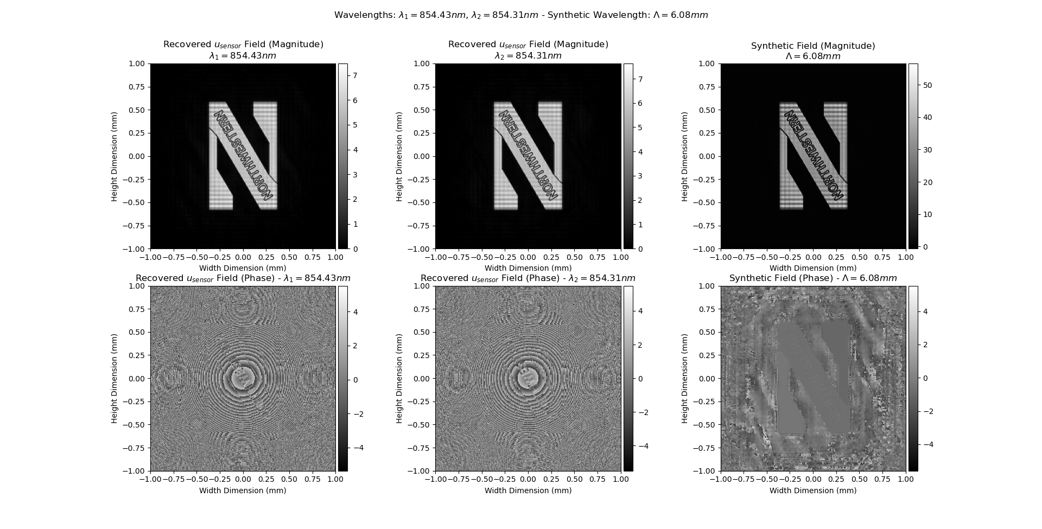

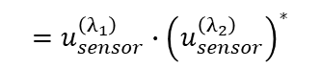
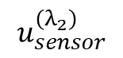
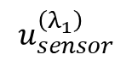
Recovered Sensor Plane Fields
$$u_{sensor}^{\left(λ_{1}\right)}$$
$$u_{synthetic}^{\left(Λ\right)}$$
$$=u_{sensor}^{\left(λ_{1}\right)}∙{\left(u_{sensor}^{\left(λ_{2}\right)}\right)}^{∗}$$
Numerical artifact
Aliasing?
Many discontinuities
Infeasible to unwrap
No difficult discontinuities
Phase related to depth
$$u_{sensor}^{\left(λ_{2}\right)}$$

Slide 20
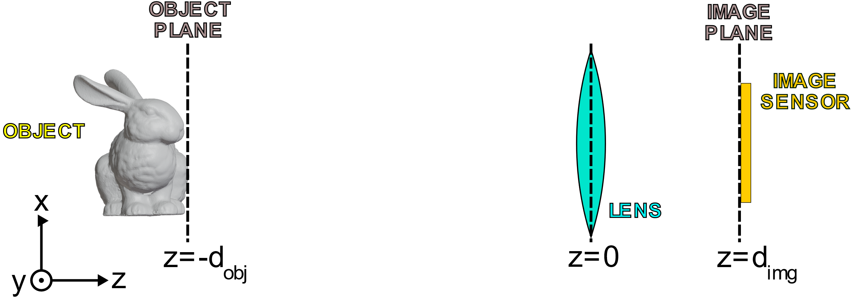
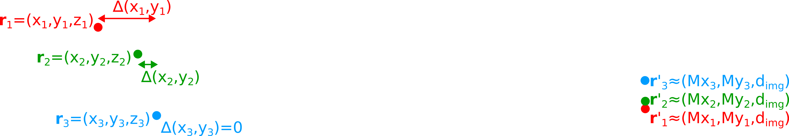











Depth Recovery Implementation Assumptions
$$Distance≈∆\left(x_{1},y_{1}\right)+d_{obj}+d_{img}$$
$$Distance≈∆\left(x_{2},y_{2}\right)+d_{obj}+d_{img}$$
$$Distance≈∆\left(x_{3},y_{3}\right)+d_{obj}+d_{img}$$
$\frac{2π}{λ}$ term gets very large for small $λ$ so if the distance approximation is even just $μ$m off, the approximation might not be good for predicting the sensor plane phase or object depth.
Phase wrapping: $\left[0, 2π\right)→[0,λ$)
Small $λ$ → Small OPL change can drastically affect phase
Sensor plane phase
If the object is sufficiently far away…
$$Φ\left(x′,y′\right)≈\frac{2π}{λ}∙\left(∆\left(x,y\right)+d_{obj}+d_{img}\right) \left(\operatorname{mod}{2π}\right)$$
$$∆\left(x,y\right)≈λ∙\left(\frac{Φ\left(x^{′},y^{′}\right)}{2π}\right)−d_{obj}−d_{img}+mλ \\ \text{for} \text{some} m∈\text{ℤ}$$
$Distance≈$ $∆\left(x_{1},y_{1}\right)$ $+d_{obj}+d_{img}$
$$OPL≈\left\|r_{i}^{′}−r_{i}\right\|$$
The code ASSUMES that the phase at the image sensor is proportional to distance in z-direction.
[
This seems like for small $λ$, this could be a bad approximation in certain cases.
I assumed it would be okay for larger synthetic wavelengths, but I am unsure if my assumption was correct.
Assuming free space, disregarding lens thickness, ignoring slight changes in image plane location due to changing points having different z coordinates, ignoring lens imperfections

Slide 21

Recovered Depthmaps from Synthetic Data
Median filter
(To remove spikes)
Gaussian filter
(See 2020 WISHED paper)

Slide 22

Recovered Depthmaps (3D Visualization)

Slide 23
Caveats for depth recovery implementation/results
I overlooked some details in the 2020 WISHED paper
Did not use two synthetic wavelengths for unwrapping
Did not recover fields at object plane
I was not able to figure out if it was necessary to do so or not
Section 4.1 of the 2020 WISHED paper mentions recovering the object plane fields though
I am not sure if my synthetic data was valid
Unsure if object plane fields were valid or not (see earlier slide)
Numerical artifacts in synthetic data generation
I am unsure if my underlying assumptions about how sensor plane phase corresponds to depth were correct.

Slide 24

Additional Note on Depth Recovery Results
Used a synthetic wavelength that was larger than the simulated object’s depth variation (~6mm versus 1mm respectively)
$∴$ phase fits within 0 to 2$π$
Did not do any sort of phase unwrapping in implementation
Phases were recentered around zero
Specifically, some quick optimization was performed to find the constant/absolute phase shift that minimized the variance about zero of the resulting phases.
Which, now that I think about it, I think that would be equivalent to just phase shifting everything so that the mean phase was zero.
Oops.

Slide 25
END OF SLIDES

